Slide 1
CIS 499 Home Hustler
Team: Blake Edens, Waylon Ergle, Mattia Galanti Sponsor: Mr. Paul Cuenin, Marketing Director at Greenwood Partnership Alliance
Supervisor: Dr. Farha Ali

Slide 2
Agenda
Problem Statement
Our Solution
Service Requirements
Project Constraints
Alternatives
System Design
Functionality
Look & Feel
Recap
Questions?

Slide 3
Problem Statement
Popular real estate search engines such as Zillow lack search optimization based on commuting and other costs
Commuting costs can add significant drawback to personal finances when considering:
gas consumption
depreciation
maintenance
time loss
On average, each mile of commuting will cost $170 per year
Factoring in “could have been payed” time for an employee who earns $25 per hour, each mile of commuting adds $795 per year

Slide 4
Our Solution
Home Hustler offers a search engine capable of aggregating living costs, including:
Mortgage payments
Utilities
Property tax
Commuting cost
Home Insurance (future release)
This allows to-be home buyers to find only those homes that fit their budget.

Slide 5
Service Requirements
Bridge Interactive API
Energy Information Administration API
Average electricity price by state
Average natural gas price by state
Google Maps & Street View API
Federal Reserve Economic Data API
Average mortgage rate
PHP for parsing and aggregating data
Bootstrap templates for efficient design

Slide 6
Project Constraints
Project developers involvement in other classes, projects, and jobs
One of the team members is an athlete with a busy schedule
Switching from Zillow to RESO API, due to technical and legal concerns
Decentralized data sources, difficult integration
Limited time
Problems enabling collaboration through Bluehost

Slide 7
Alternatives
Zillow
Realtor
Trulia
HomeFinder
Remax
Our Solution
Search optimization based on aggregate monthly cost estimates

Slide 8
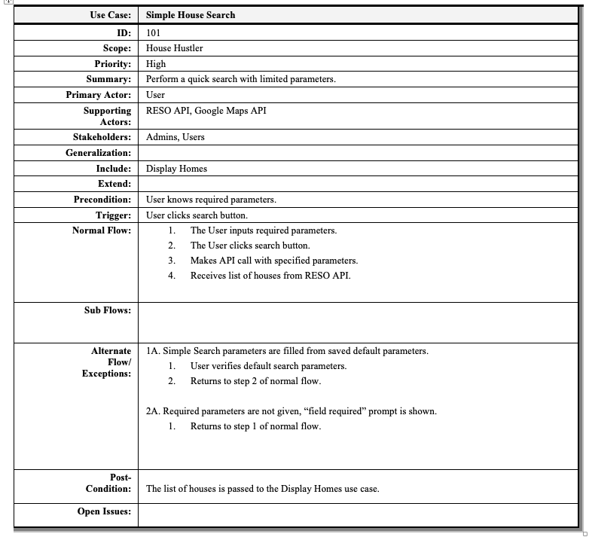

Slide 9
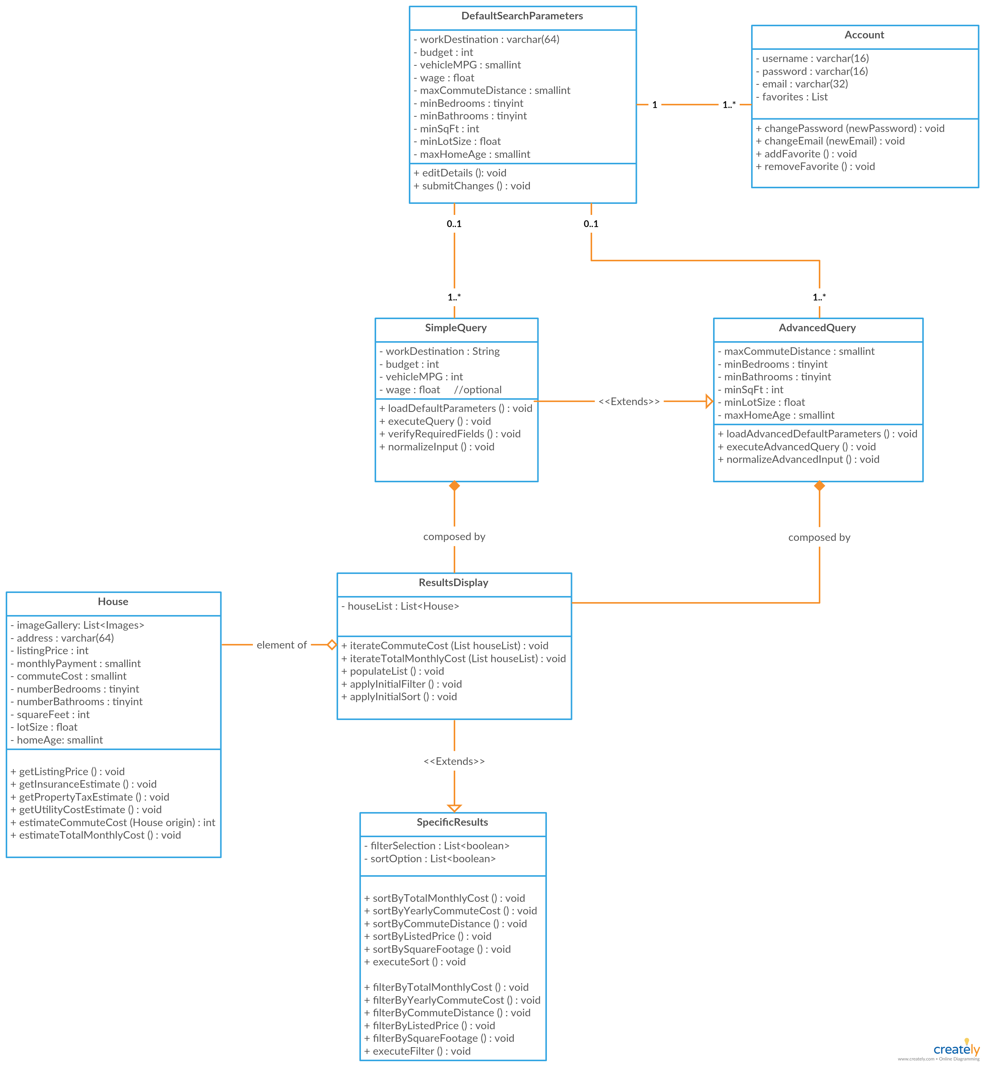

Slide 10
Functionality
Search
By cost
By square footage
By number of bedrooms/bathrooms
By distance from work location
Sort Results
By estimated total yearly/monthly cost
By estimated yearly commute cost
By commute distance
By listed price
Account Management
Creation
Modification
Login
Logout

Slide 11
Look & Feel
http://www.home-hustler.com/

Slide 12
Recap
Designing the website required:
HTML
CSS
SQL
PHP
JavaScript
jQuery
AJAX for Google Maps API calls
RESO API
Google Maps API
Utility API

Slide 13
Thanks!
Any questions?

